Slide 1
Chapter 22
Conductor and Dielectrics
in Electrostatic Field
Conductor
Capacitance
Dielectrics
Energy Stored in an Electric Field

Slide 2
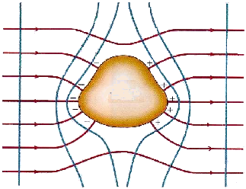
22-1. A Charged Isolated Conductor (P473)
Conductor:there exist a lot of Free moved charges.
Insulator(绝缘体): almost no free moved charges.
Semiconductor(半导体): between them.
1. Interaction between electrostatic field and conductor
A conductor in uniformly electric field :

Slide 3
electrostatic field
导体
free charges redistributing
静电感应
(electrostatic induction)
electrostatic equilibrium (静电平衡状态)导体内部和表面都没有电荷的宏观移动
-
-
+
+
-
+
-
-
+
+
-
+
-
E=0
+
-
+
-
+

Slide 4
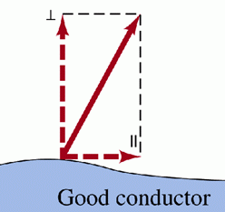
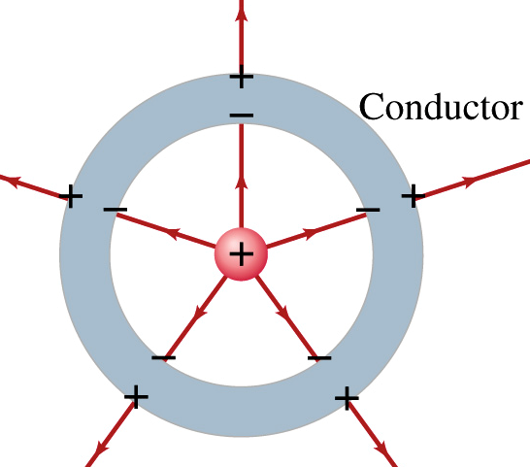
2. Condition of electrostatic equilibrium (静电平衡)
1
The electric field inside conductor must be zero.
2
Electric field at and just outside the conductor's surface must be perpendicular to that surface (导体表面的电场强度垂直于导体表面).
P473
If it were not, then it would have a component along the conductor's surface that would exert forces on surface charges, causing them to move.

Slide 5
3
The potential of conductor at any point is constant. That is, conductor, inside and its surface, are equipotential (导体是等势体,表面是等势面)(P511).
i.e. V = C
Proof:
Choose two arbitrary points a & b in a conductor,
导体等势是导体体内电场强度处处为零的必然结果
Another expression of the condition of electrostatic equilibrium

Slide 6
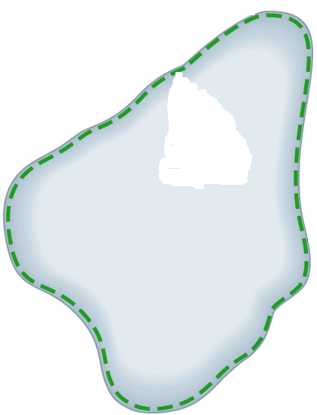
3. Distribution of charges on conductor under the electrostatic equilibrium (P495)
Choose an arbitrary G.S. in the internal conductor. From Gauss’ Law,
P
S
—— there is no net charge in any small volume of internal conductor
1
Charge placed on an isolated conductor will move entirely to the surface of the conductor. None of the excess charge will be found within the conductor (导体内净电荷为零).

Slide 7
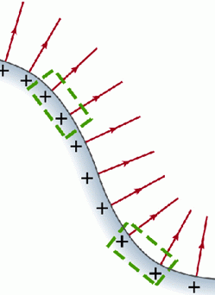
2
The magnitude of the at a location just outside a conductor (导体外表面)is proportional to surface charge density at that location on the conductor.
(P494)
ΔS'
q=σΔS
—— 空间电场与导体电荷相互作用达到平衡的结果。
E: produced by all charged bodies in the space.
σ: related to all charge distribution in the space.

Slide 8
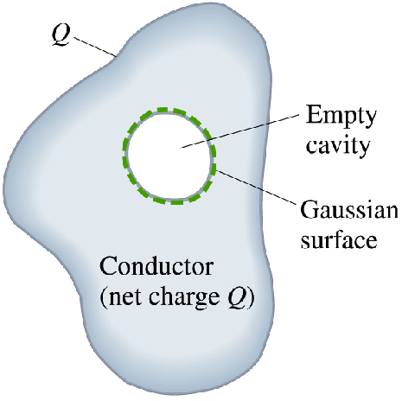
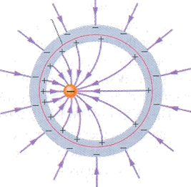
3
An isolated conductor with a cavity (P495)
(a) There is no net charge on the inside the cavity walls if no charges inside the cavity (腔内无电荷时，空腔内表面不会有电荷分布).
(b) If there is charge +q in the cavity, then it induces –q at inner surface and all excess charge remains on the outer surface of the conductor.

Slide 9
4
The surface charge density outside the surface of a conductor is related to the radius at that location on the conductor (导体外表面的电荷密度与该处曲率半径有关).
Far away from each other
r₂
r₁
尖端放电
+

Slide 10
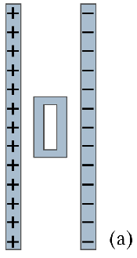
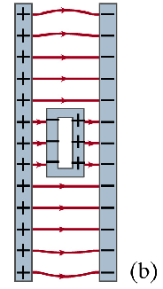

4. Electrostatic shielding (静电屏蔽)(P473)
+
Think of: Will the electric field of outer charges enter into conductor or cavity
?

Slide 11
Example:
A conducting sphere, of radius R and charge +q, is concentric with a spherical conducting shell of inner radius R₁ and outer radius R₂. This shell has a net charge of Q. (a) What are the charges on the inner and outer surfaces of the shell? (b) The potential of the sphere and the shell?
Solution:
B
A
Spherical symmetry, q uniformly distributed at inner surfaces
(a) Q_{in} = -q (by using Gauss’s law)
conservation of charges

Slide 12
(b) Potential of the shell B
B
A
Potential of the sphere A
—similar to 3 charged spherical shell in vacuum.
If A and B are connected by a long metal wire, what effects will it result?
Question:

Slide 13
Example:
Two parallel-conducting-plates with same area (S>>d²). They charged Q_{A} and Q_{B} respectively. Find the surface density at each face of the plates under electrostatic equilibrium.
Solution:
Assume surface density is σ
S
From conservation of charges law,
P_{B}
Considering the point P_{B} in plate B,
d

Slide 14
Plot a Gauss’s surface S', we have
S
P_{B}
S'
d
Think that if the plate B is connected to the ground, then
σ₁= σ₄ = 0

Slide 15
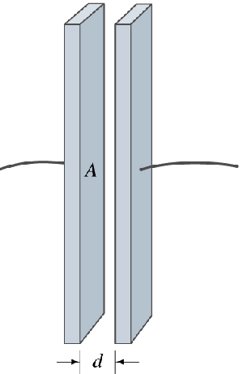
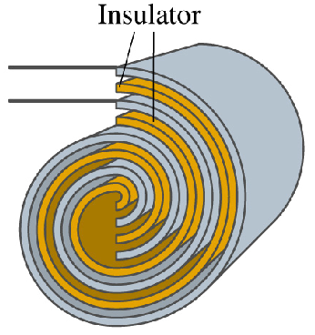
22-2. Capacitor and Capacitance (P525)
Capacitors have many uses in our electronic and microelectronic age beyond serving as storehouses for potential energy. As one example, they are vital elements in the circuits with which we tune radio and television transmitters and receivers.
As another example, microscopic capacitors form the memory banks of computers.

Slide 16
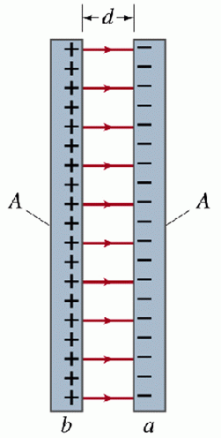
A parallel-plate capacitor (平行板电容器), consisting of two parallel conducting plates (A ,d).
Because the plates are conductors, they are equipotential surfaces; all points on a plate are at the same electric potential.
The charge q and the potential difference V for a capacitor are proportional to each other;
—— capacitance of capacitor

Slide 17
Its value (固有容电本领) depends only on the geometry (几何因素) of plates, dielectric property and not on their q or V.
The capacitance is a measure of how much charge must be put on the plates to produce a certain V between them: The greater the capacitance, the more charge is required.
SI unit: coulomb per volt farad (F) (法拉)
Dimension:
Look at page 526 of text book

Slide 18
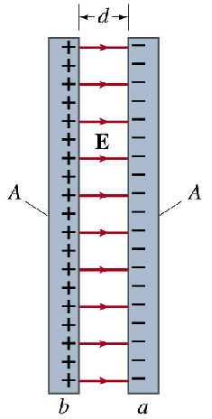
Calculating the capacitance (P526):
Assume
A parallel-plate capacitor:
Assume σ, A and d. (the fringing of the at the edge of plates can be neglected)
— (parallel-plate capacitor)

Slide 19
A cylindrical capacitor (圆柱形电容器):
In the region of ,
—— (cylindrical capacitor)
Capacitance of unit length
—— depends only on geometrical factors, in this case L, R₁ and R_{2.}

Slide 20
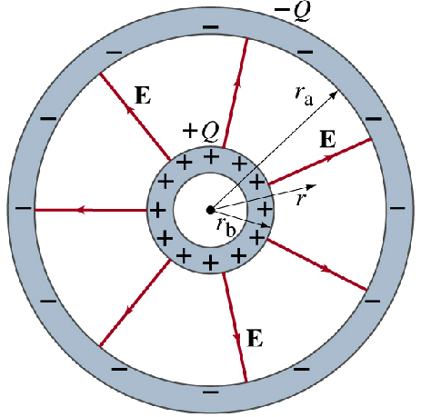
A spherical capacitor (球形电容器):
-q
In the region of ,
R_{B}
q
R_{A}
—— (spherical capacitor)
Capacitor of an isolated sphere (孤立导体的电容):

Slide 21
Look at Sec. 22-3 of textbook by yourself, please.
22-3. Capacitor with a Dielectric (P533)
1. Dielectrics in electrostatic field
If you fill the space between the plates of a capacitor with a dielectric, what happens to the capacitance? Michael Faraday—to whom the whole concept of capacitance is largely due and for whom the SI unit of capacitance is named—first looked into this matter in 1837. He found:

Slide 22
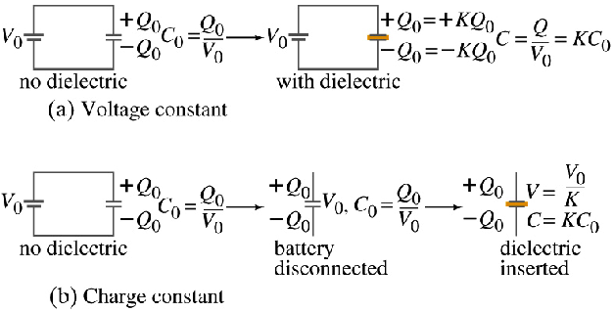
As the figure 22-12 in P 534 shown:
(1) The capacitance increased by a numerical factor κ, which he called the dielectric constant of insulating material (or ε_{r}).

Slide 23
(2) Dielectrics break down less readily than air, so higher voltages can be applied without charge passing across the gap (the potential difference that can be applied between plates to a certain value V_{max}, called breakdown potential.
Faraday discovered that the capacitance with a
dielectric completely filling with the space between
the plates is
In a region completely filled by a dielectric material of dielectric constant κ, all electrostatic equations containing the permittivity constant ε₀ are to be modified by replacing ε₀ with κε₀.

Slide 24
When a point charge is inside a dielectric medium, it produces an electric field with the magnitude
The electric field outside an isolated conductor
immersed in a dielectric is
For a fixed distribution of charges, the effect of a dielectric is to weaken the electric field that would otherwise be present (P535).

Slide 25
2. Molecular description of dielectrics (P536)
(1) Polar (有极分子) Dielectrics. The molecules of some dielectrics, like H₂O and CO, have permanent electric dipole moments.
+ -
In such materials, the electric dipoles tends to line up with an external electric field.
(2). Nonpolar (无极分子) Dielectrics. The dielectrics (such as H₂, N₂) have no permanent electric dipoles.
+-

Slide 26
No external electric field: random thermal motion, —— neutralized (电中性)
Polar Dielectrics
Nonpolar Dielectrics
Under external electric field: whether there are permanent electric dipoles or not, tends to “stretch” the molecules.

Slide 27
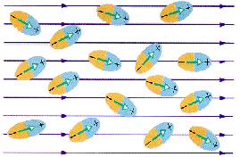
Polar molecule, orientation polarization (取向极化)
Non-polar ~ , displacement polarization(位移极化)
common effects: appearing surface charges on the slab faces
Effects of dielectrics polarizing——generating polarization charges or bound charges (束缚电荷) and polarization field (产生退极化场) within medium.

Slide 28
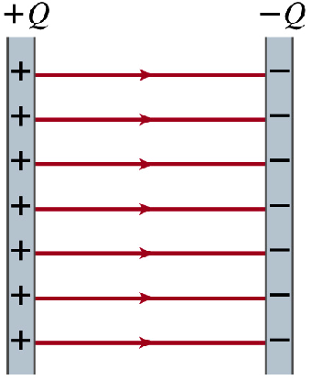
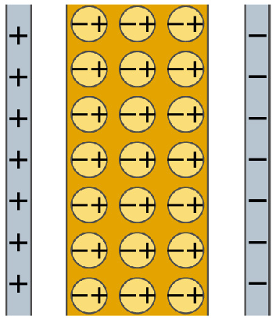
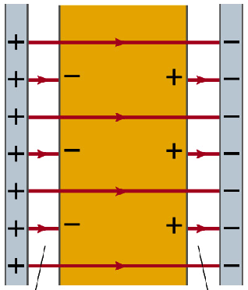
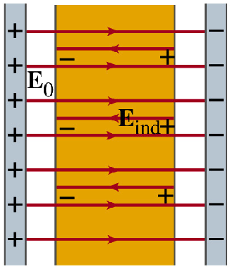
The net field inside the dielectric has the same direction with but smaller in magnitude. So the effect of dielectric is to weaken the electric field.

Slide 29
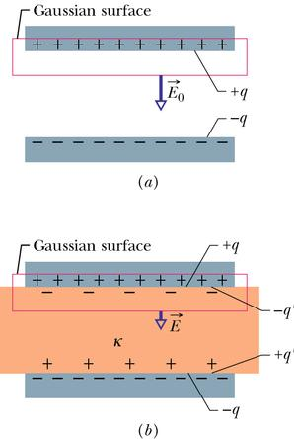
3. Dielectrics and Gauss’ law
From Gauss’ Law, without dielectric,
Take Notes
With the dielectric in space in Fig.(b),
q′=0, if no dielectric is present, then κ=1.

Slide 30
(Gauss’ law with dielectric)
This important equation, although derived from a parallel-plate capacitor, is generally true！
Define a new quantity:
electric displacement (电位移矢量),
then
The flux of the electric displacement through a closed surface of any shape equals to the algebraic sum of free charges enclosed within the surface. 通过任一闭合曲面的电位移通量,等于该曲面内所包围的自由电荷的代数和.

Slide 31
Explanations:
(1) is only a supplementary physical quantity, and has no real physical meaning like . If a test charge is put in electric field, the force acted on it is determined by but .
(2) The sum in the right side does not include bounded (induced) charge, but free charge only ! (taken fully into account by introducing κ & .
(3) The unit of is C/m² .

Slide 32
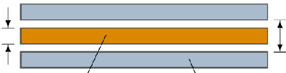
Example:
A parallel-plate capacitor of plate area A and plate separation d. A potential difference V₀ is applied between the plates. The battery is then disconnected, and a dielectric slab of thickness b and dielectric constant κ is placed between the plates.
b
d
(a) What is the capacitance C₀ before the dielectric slab is inserted?
k
A
(b) What free charge appears on the plates?
Solution:
(a)
(b)
Note that the free charge remains unchanged as the slab is put into place since charging battery was disconnected before the slab was introduced.

Slide 33

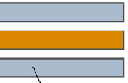


(c) What is the electric field E₀ in the gaps between the plates and the dielectric slab?
b
d
E₀ does not change as the slab is introduced since q is constant.
(d) What is the electric field E₁ in the dielectric slab?
介质中，先求D，再求E！

Slide 34
(e) What is the potential difference V between the plates after the slab has been introduced?
It is less than the original potential difference.
(f) What is the capacitance with the slab in place?
The key idea now is that the capacitance C is just related to the free charge q and the potential difference V.
This is greater than the original capacitance.
b
d
Look at examples 22-8 & 22-9 of textbook.

Slide 35
22-4. Electric Energy Storage (P532)
As the figure, a charge q has been transferred from one plate of a capacitor to the other. The potential difference V ´ between the plates at that instant will be q/C.
+q
-q
dq
If an extra increment of charge dq is then transferred, the increment of work required will be:
A
B
The work required to bring the total capacitor charge up to a final value Q is:

Slide 36
This work is stored as potential energy U in the capacitor,
电容器(Q)储能
It holds no matter what the geometry of the capacitor is.
?
Where does the energy distribute
⎯⎯能量储存于电场中
The potential energy of a charged capacitor may be viewed as being stored in the electric field between its plates.
Look at the example 22-7 in P533, please!

Slide 37
To express the energy by characteristic quantity of electric field and find out the density of energy (场能密度), we may still use the above special case.
(where Ad is: the volume of capacitor)
The energy for unit-volume:
energy density (电场能量密度)
u is proportion to the square of E. So the more the electric field E, the greater is the energy of electric field.

Slide 38
Although we derived this result for the special case of a parallel-plate capacitor, it holds generally, whatever may be the source of the electric field.
If an electric field exists at any point in space, we can think of that point as a site of electric potential energy whose amount per unit volume is given by this equation:

Slide 39
Example:
A coaxial cable (同轴电缆) has radii a and b in Fig.
The space against the inner-wall of the cylindrical is fill with dielectric material κ of inner radius R,(a) If the
linear density of conductor rod & cylinder is ±λ, find .
l
Solution:
r
a
b
R

Slide 40
(b) Find the capacitance in unit length.
l
r
a
b
R

Slide 41
(c) Find the energy of electric field in unit length.
Way I, 用电容器储能计算:
Way II, 用电场能量计算:
Comparing with C can be gotten!求电容方法!

Slide 42
Example:
A cylindrical capacitor has radii a and b (where b>a). Show that half the stored electric potential energy lies within a cylinder whose radius .
Solution:
Let ,
we have

Slide 43
The problems of chapter 22:
15, 19, 26, 48, 49, 50, 56, 57, 65, 84, 85

